Slide 1
DEVELOPING USE CASES
A use case tells a stylized story about how an end user (playing one of a number of possible roles) interacts with the system under a specific set of circumstances.

Slide 2
The story may be narrative text, an outline of tasks or interactions, a template-based description, or a diagrammatic representation.
Regardless of its form, a use case depicts the software or system from the end user’s point of view.
The first step in writing a use case is to define the set of “actors” that will be involved in the story.
Actors are the different people (or devices) that use the system or product within the context of the function and behavior that is to be described.
Actors represent the roles that people (or devices) play as the system operates.
Defined somewhat more formally, an actor is anything that communicates with the system or product and that is external to the system itself.
Every actor has one or more goals when using the system.

Slide 3
Because requirements elicitation is an evolutionary activity, not all actors are identified during the first iteration.
It is possible to identify primary actors during the first iteration and secondary actors as more is learned about the system.
Primary actors interact to achieve required system function and derive the intended benefit from the system.
They work directly and frequently with the software.
Secondary actors support the system so that primary actors can do their work.

Slide 4
Recalling basic SafeHome requirements, we define four actors: homeowner (a user), setup manager (likely the same person as homeowner, but playing a different role), sensors (devices attached to the system), and the monitoring and response subsystem (the central station that monitors the SafeHome home security function).
The homeowner actor interacts with the home security function in a number of different ways using either the alarm control panel or a PC:
• Enters a password to allow all other interactions.
• Inquires about the status of a security zone.
• Inquires about the status of a sensor.
• Presses the panic button in an emergency.
• Activates/deactivates the security system.

Slide 5
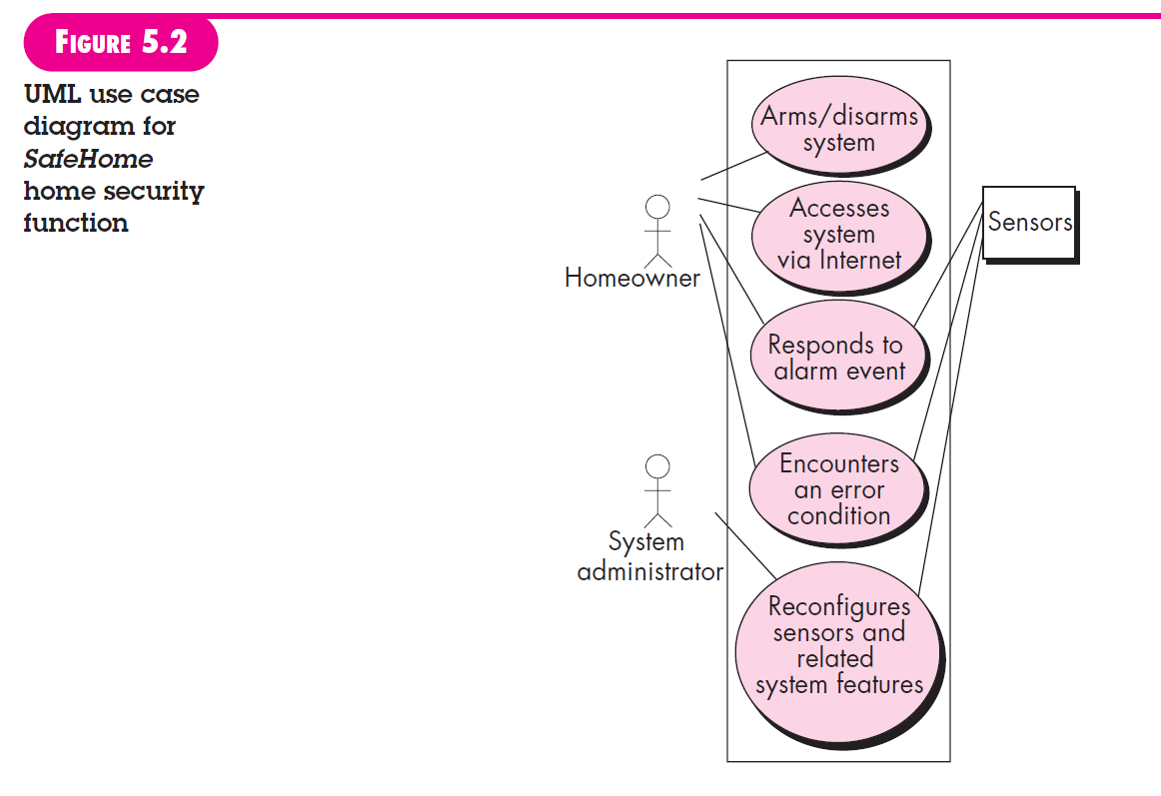

Slide 6
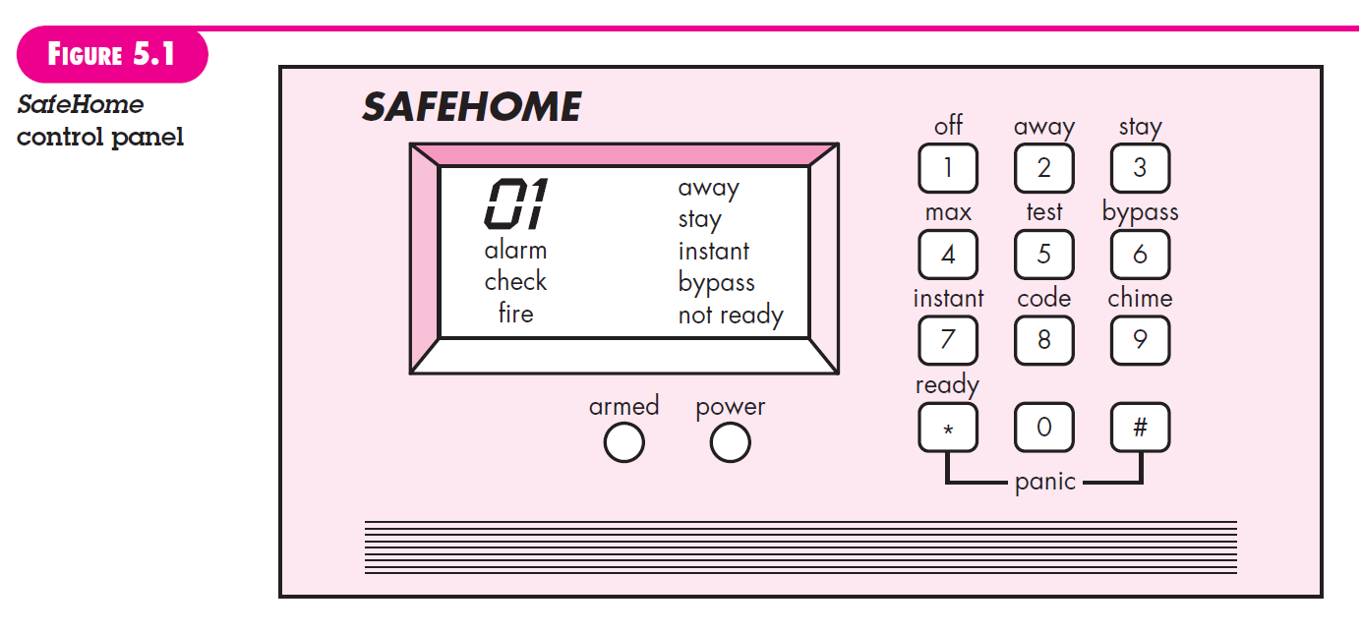

Slide 7
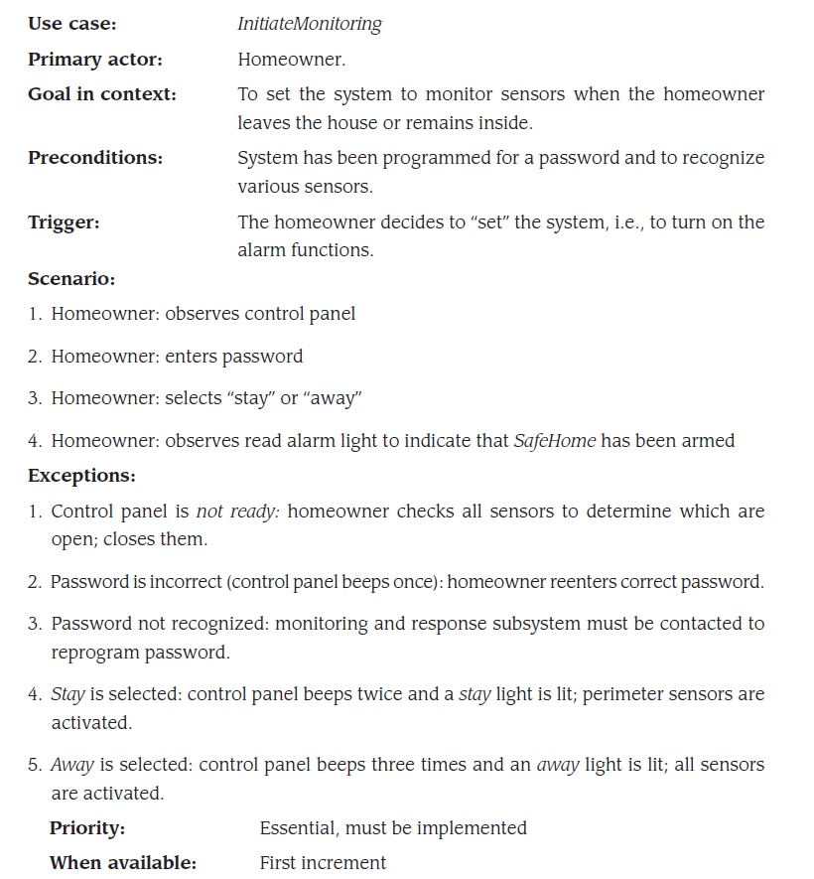

Slide 8
